Slide 1
Artificial Intelligence in the Diagnosis of Common Cancers in Women
In the name of God
Seyed Mohammad Ayyoubzadeh
PhD in Medical Informatics
Tehran University of Medical Sciences

Slide 2
Quick poll
How familiar are you with AI tools?
1: Beginner (never used AI tools).
2: Intermediate (some exposure).
3: Advanced (actively use AI tools).

Slide 3
Introduction
Artificial intelligence (AI) is transforming the diagnosis of common cancers in women, including:
Breast
Cervical
Ovarian
Endometrial
Lung cancers

Slide 4
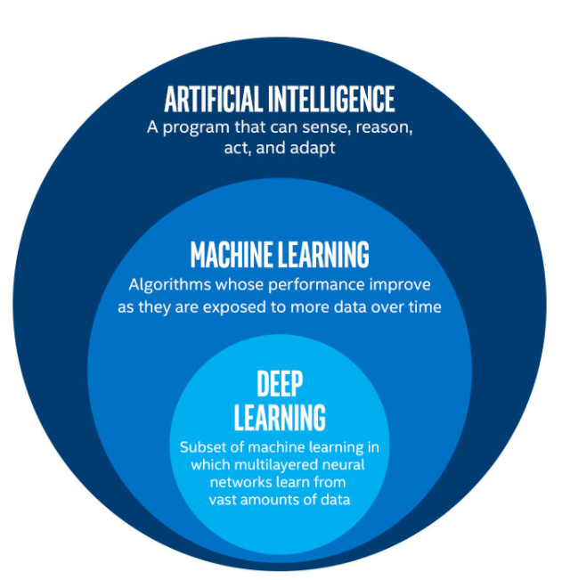

Slide 5
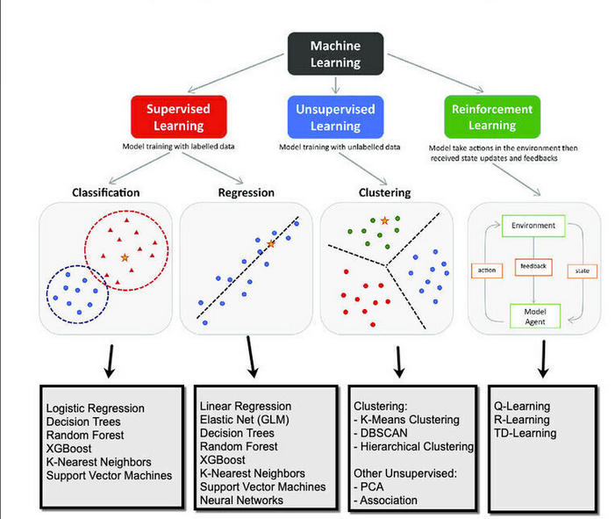

Slide 7
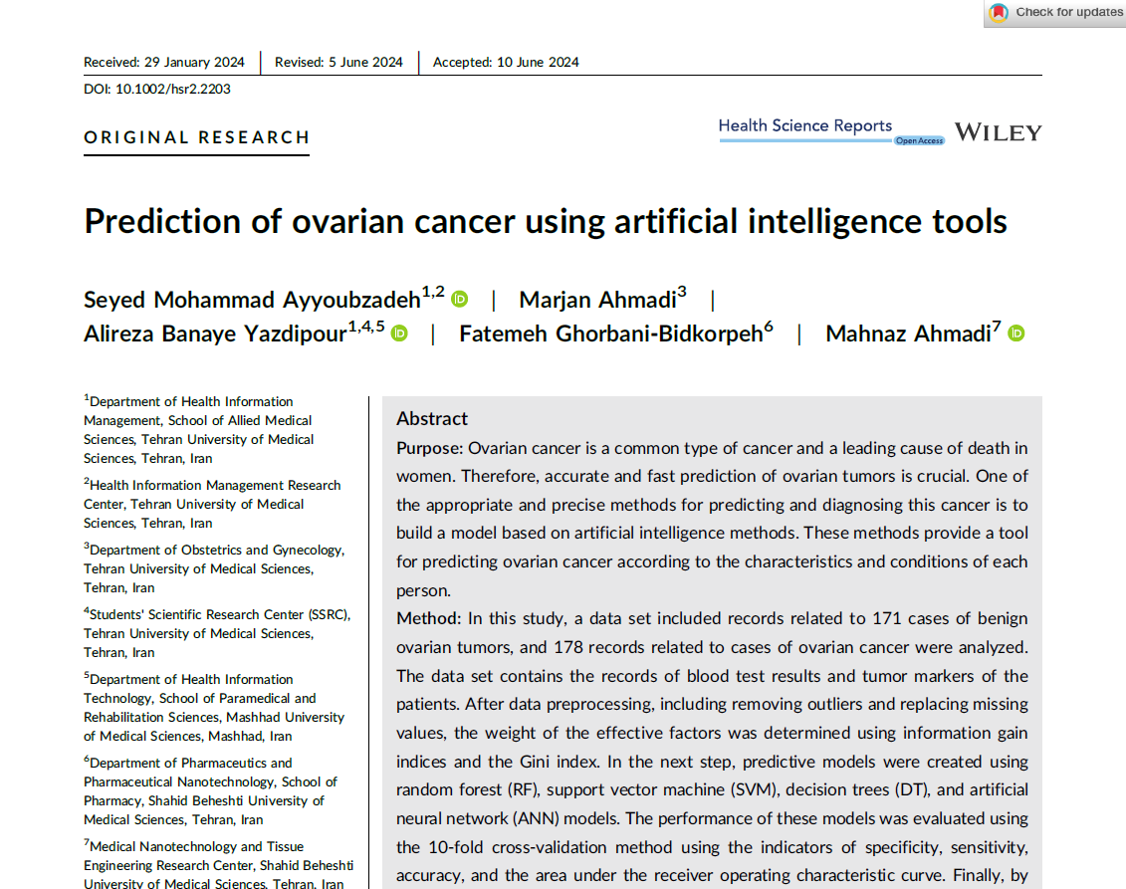

Slide 8
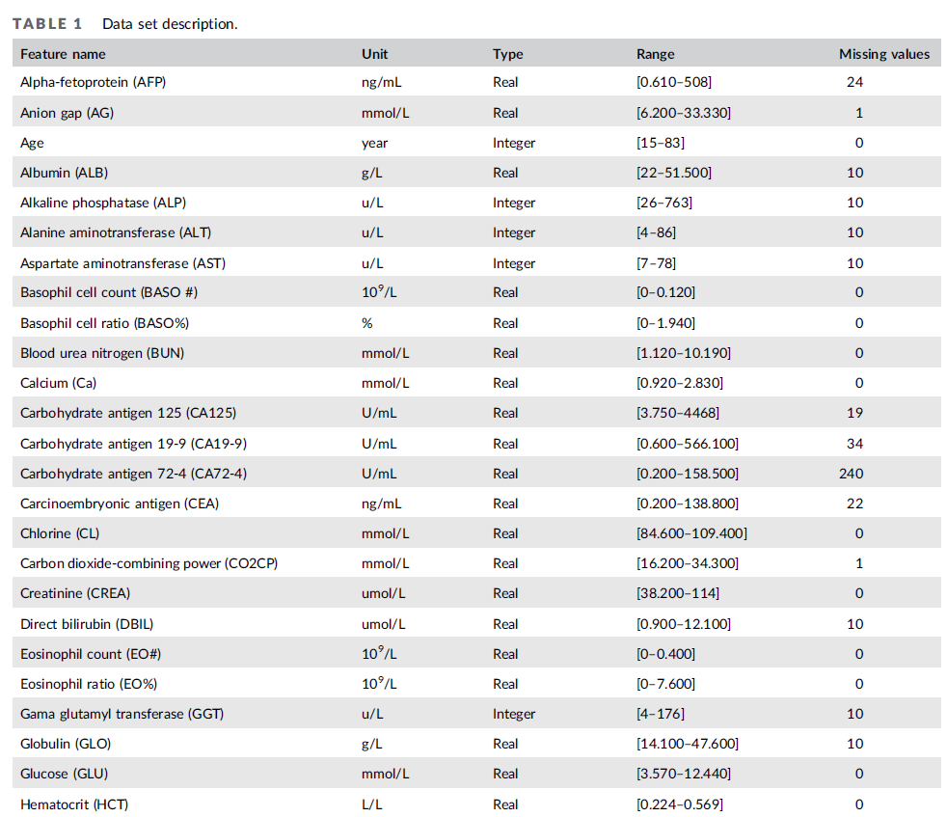

Slide 9
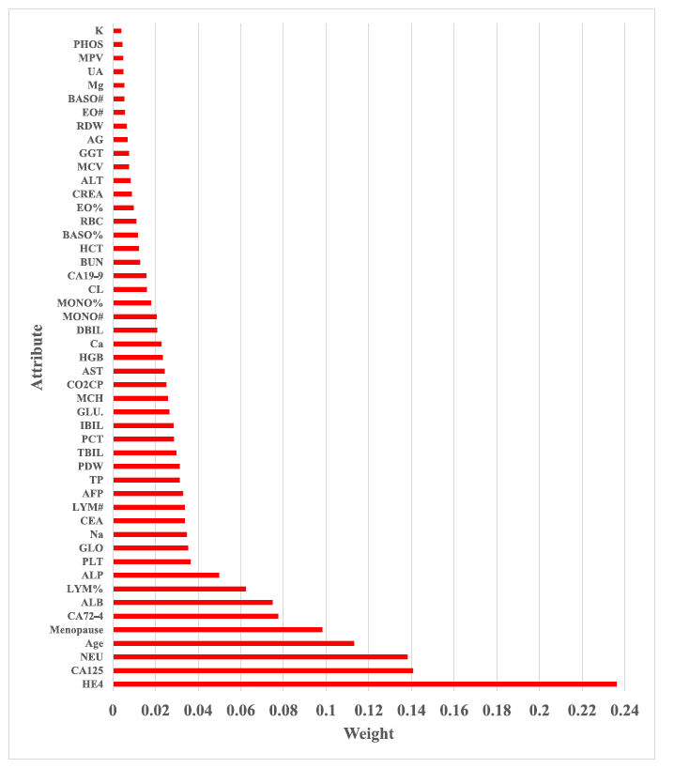
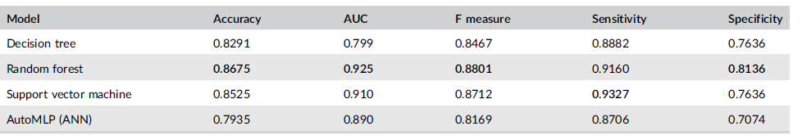
Machine learning or deep learning?

Slide 10
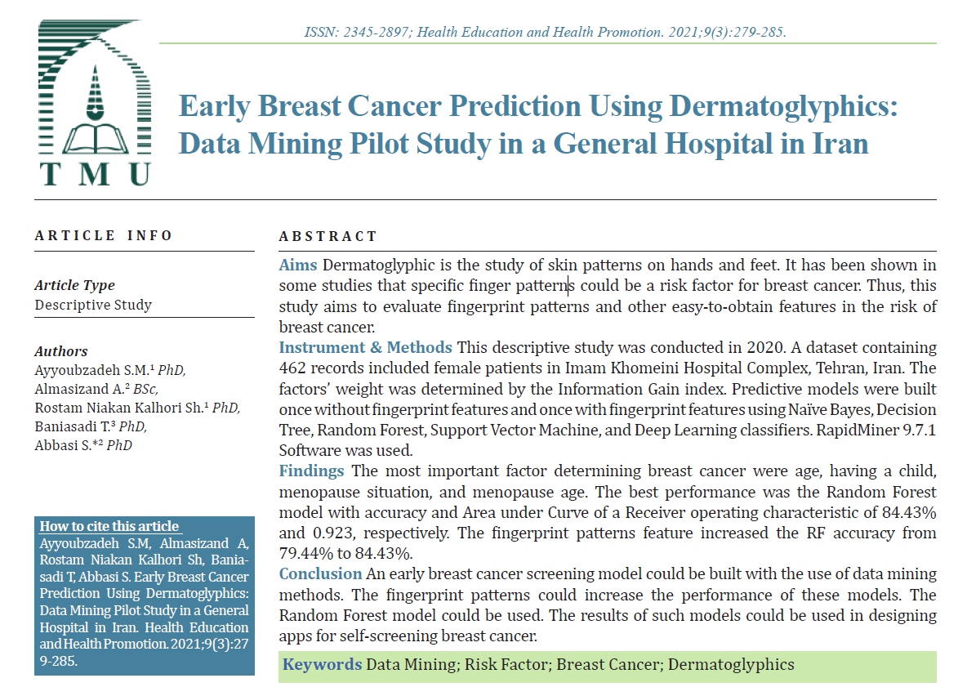

Slide 11
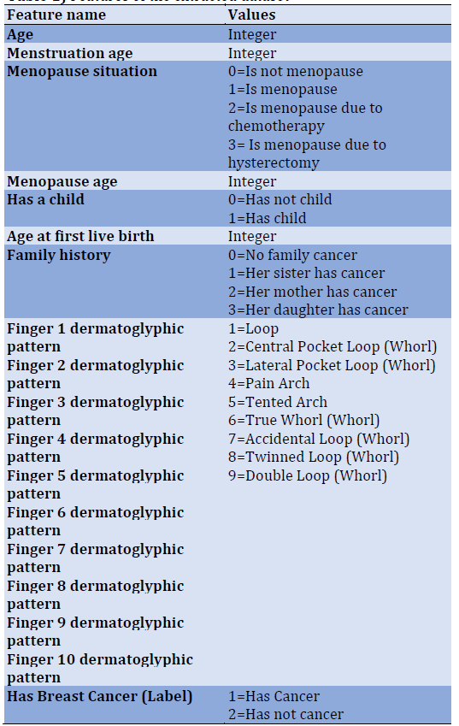
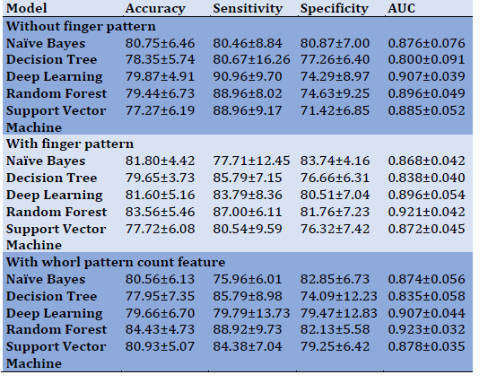
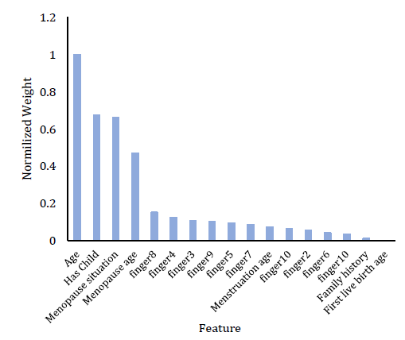
Screening
Machine learning or deep learning?

Slide 12
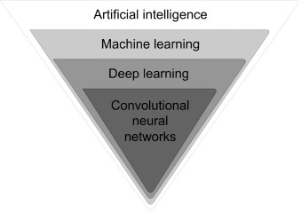
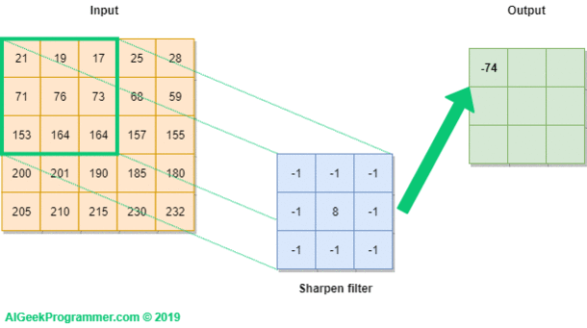
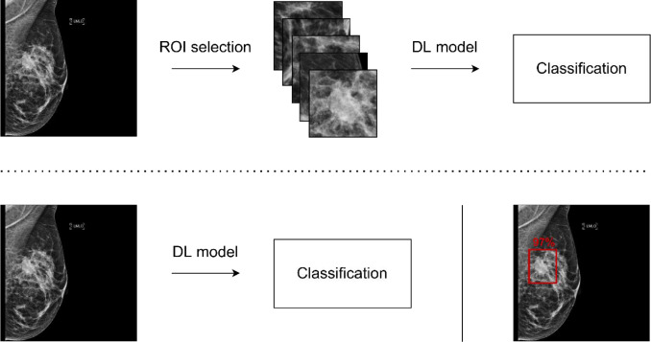

Slide 13
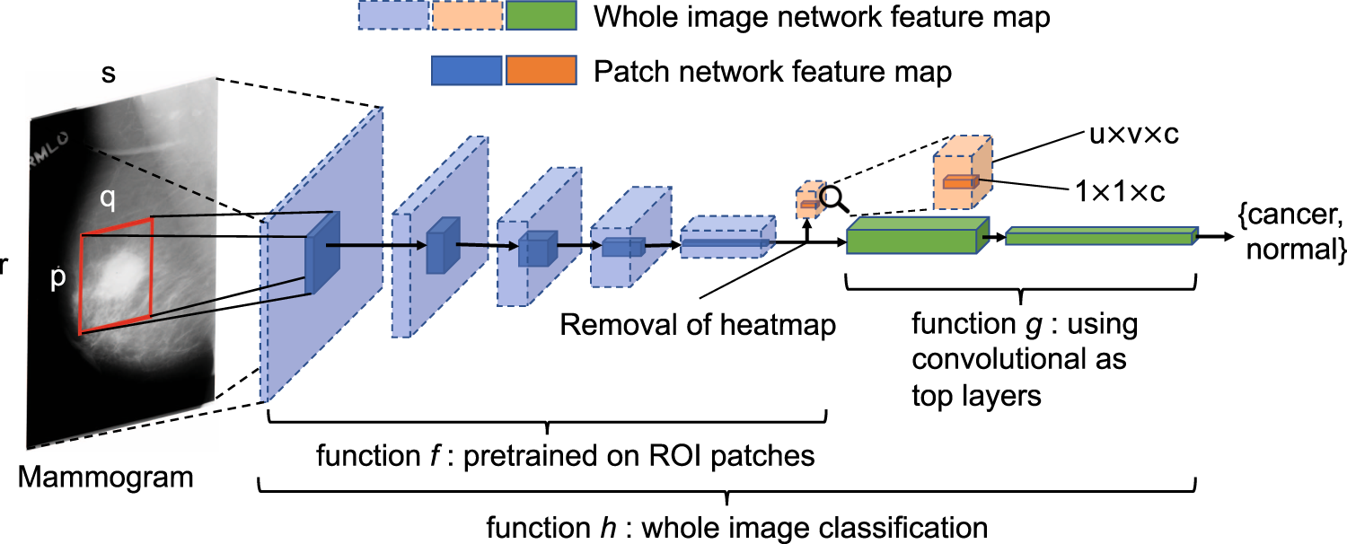

Slide 14
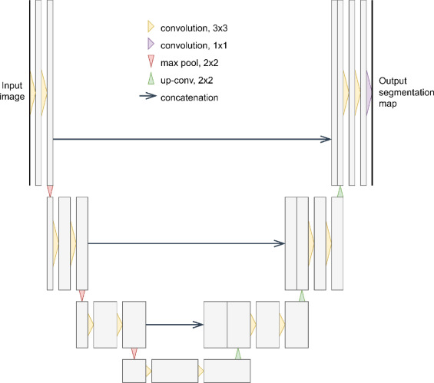

Slide 15
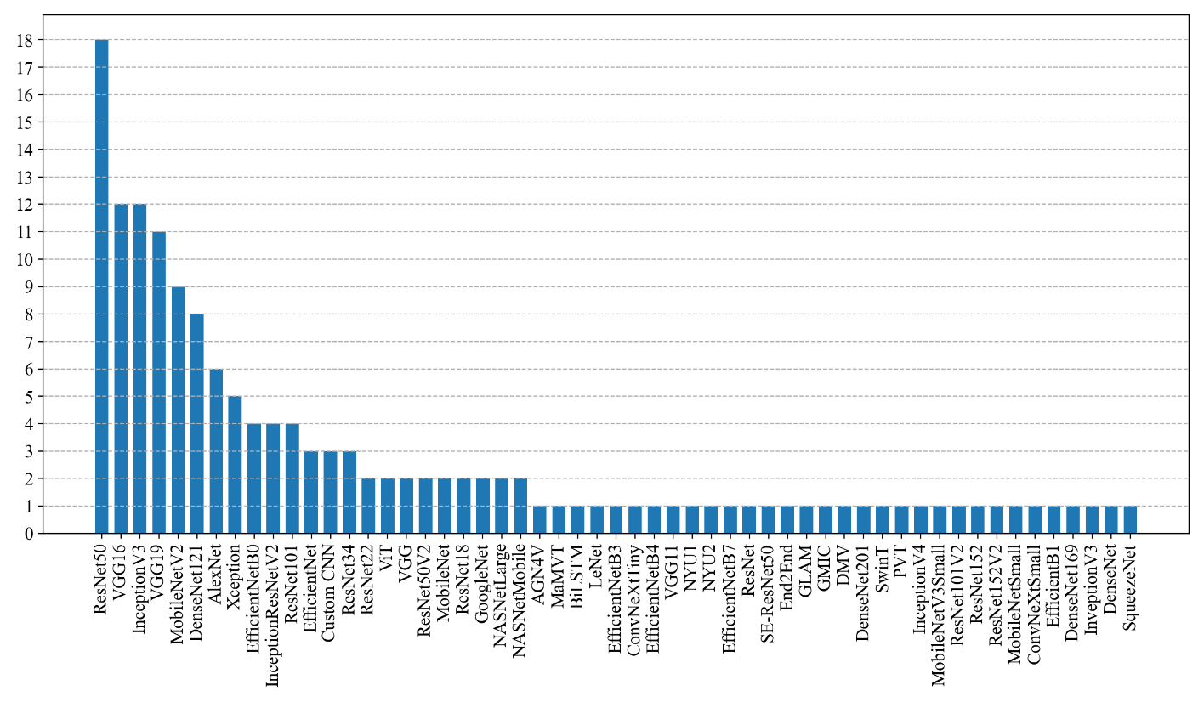
Breast Cancer Diagnosis Deep Learning Models

Slide 16
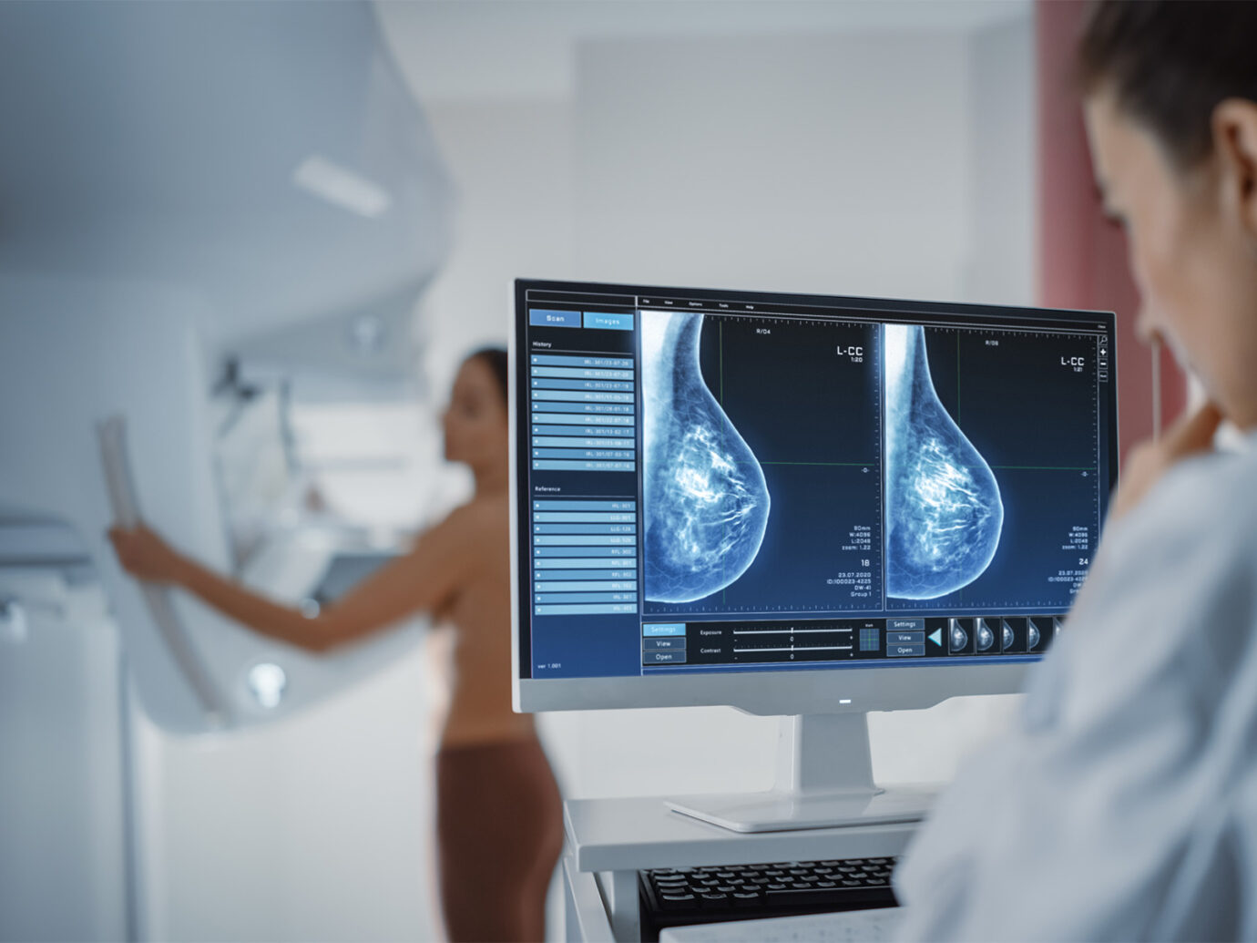
ProFound Breast Health Suite

Slide 17
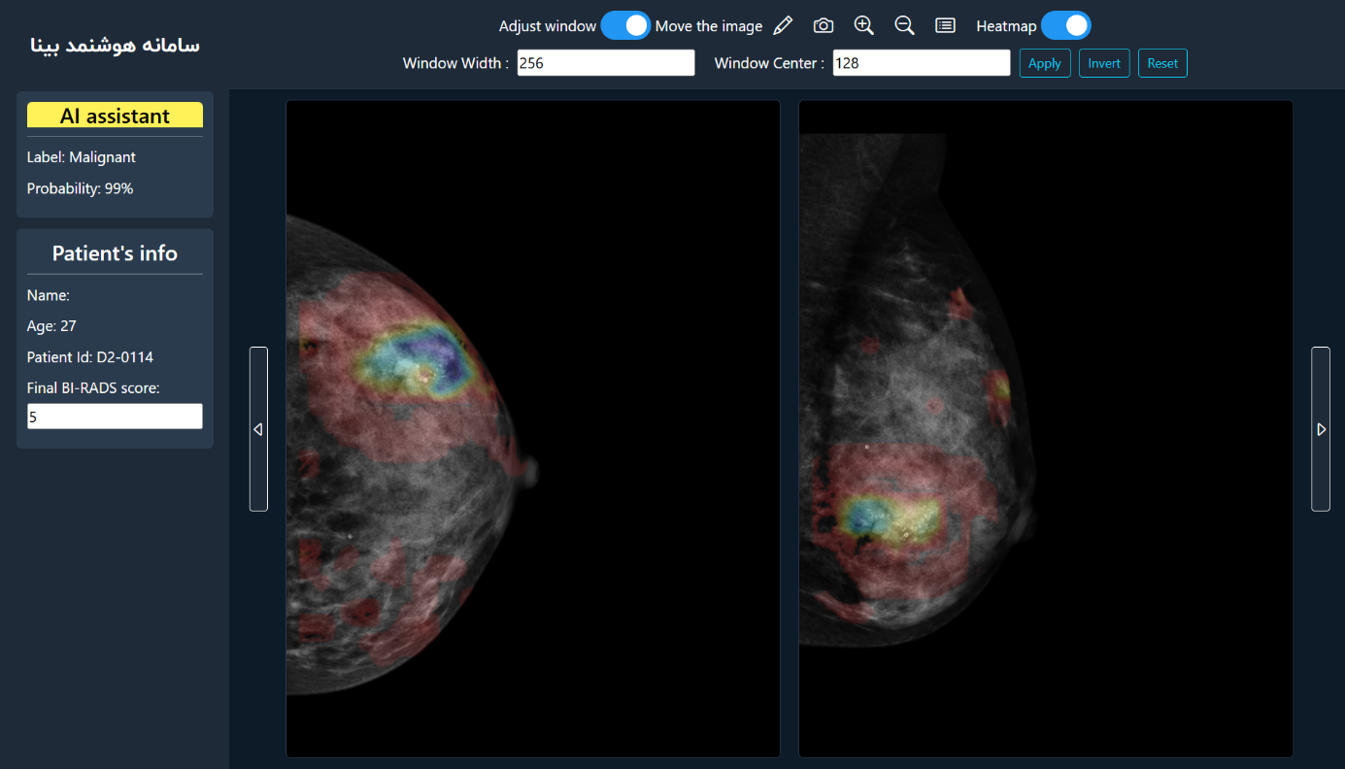
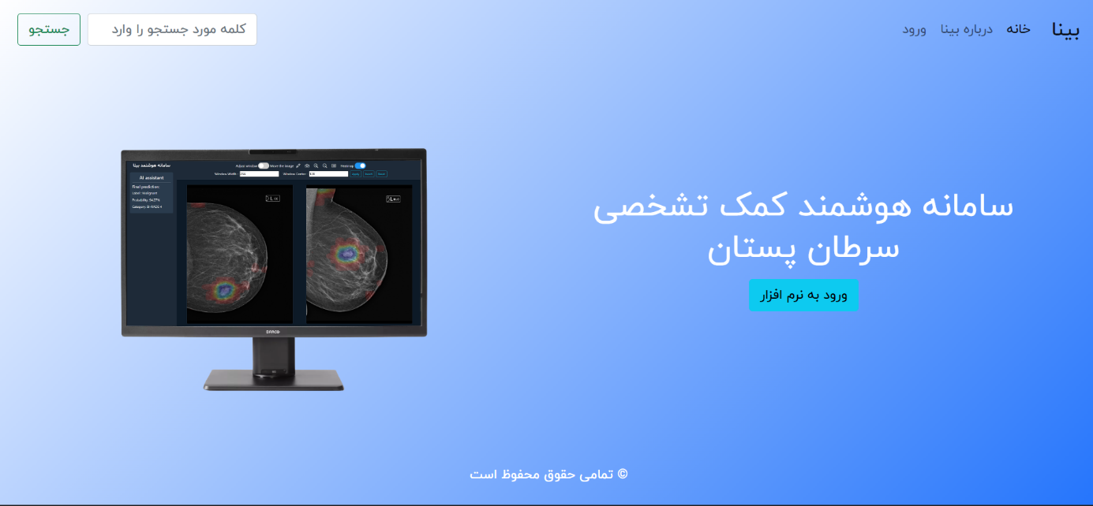
سامانه هوشمند کمک تشخیصی سرطان پستان
Grad-CAM

Slide 18
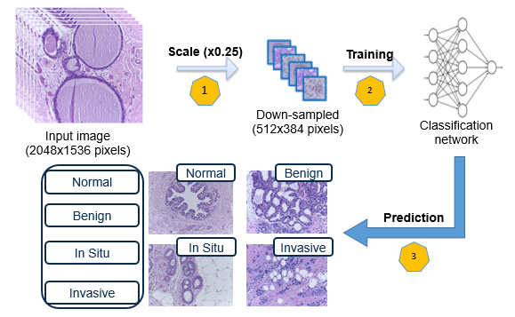
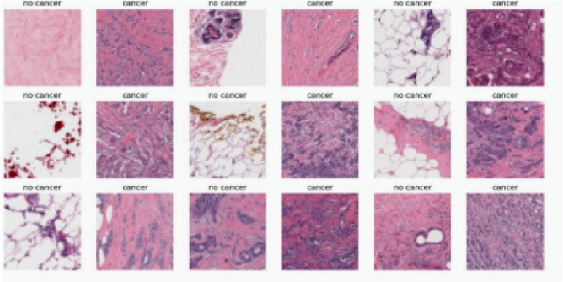

Slide 19
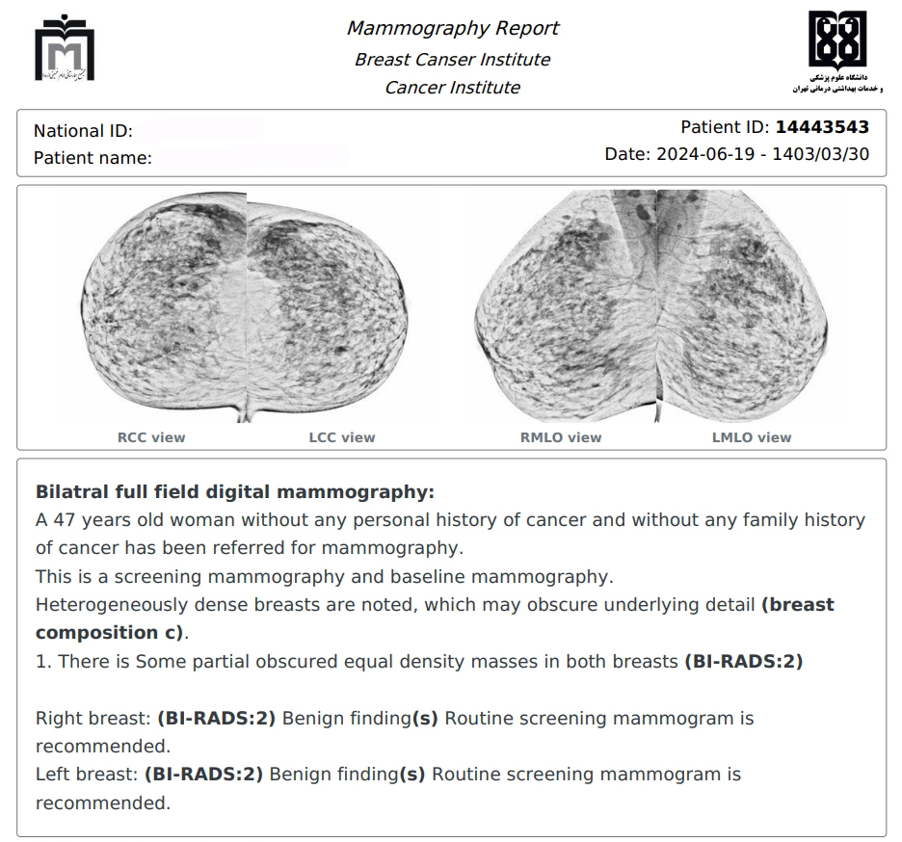
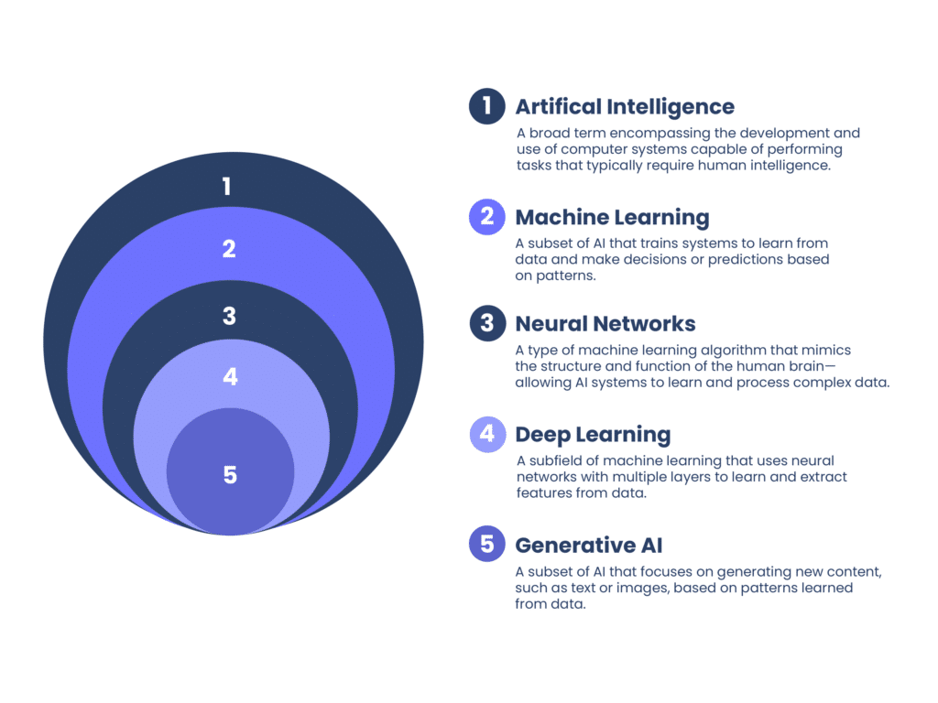

Slide 20
Datasets
https://paperswithcode.com
https://www.kaggle.com
https://datasetsearch.research.google.com

Slide 21

Seyed Mohammad Ayyoubzadeh
PhD in Medical Informatics
Tehran University of Medical Sciences
S.M.Ayyoubzadeh@gmail.com
+98 912 7974887

